Slide 1
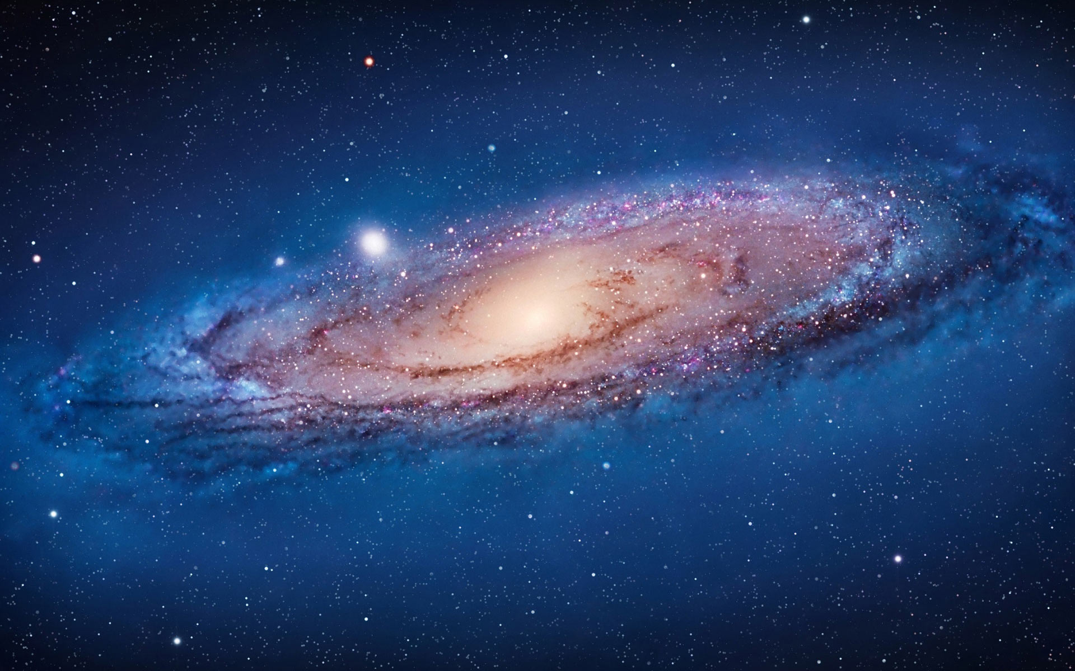
Final Capstone – Galaxy Image Classification
Jeff Biehle
September 13, 2019

Slide 2

A little bit about me. . .
Live in Dripping Springs, TX
Outside Austin, “just west of ‘Weird’ “
30+ years in high-tech
Primarily business development/strategic alliances
Decided I needed a career switch
Have been intrigued with data science for several years
Joined Thinkful in February

Slide 3





Overview
Why
Galaxies?
The
question(s)
Data
fun!
Model Selection/
Tuning
Conclusion/
Challenges

Slide 4
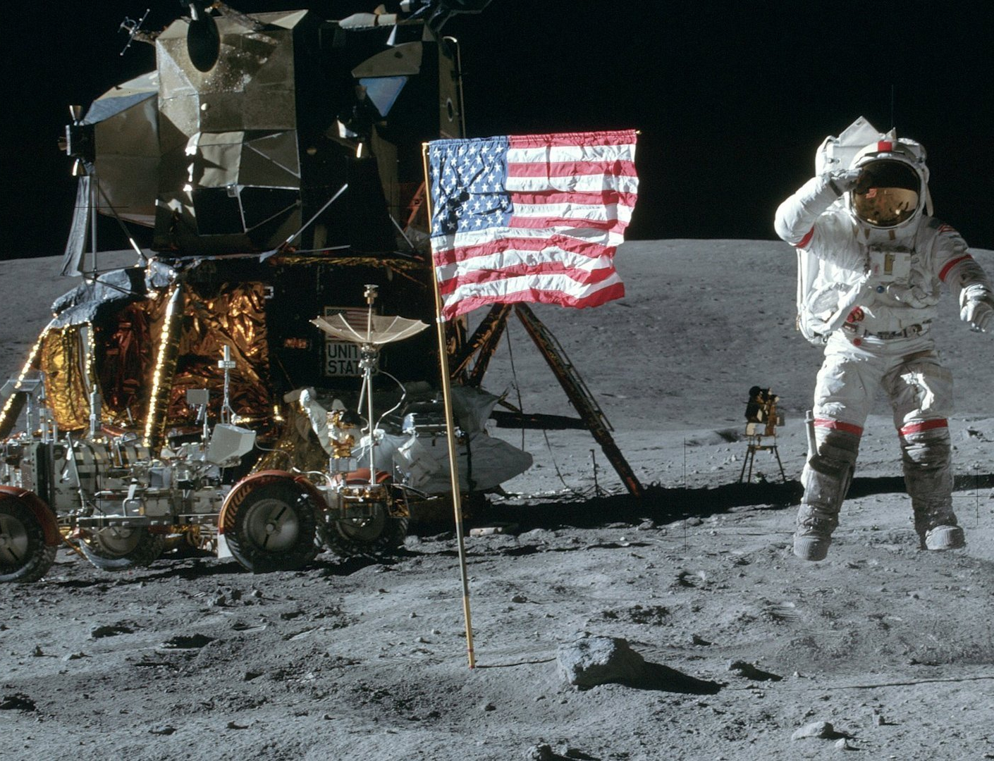
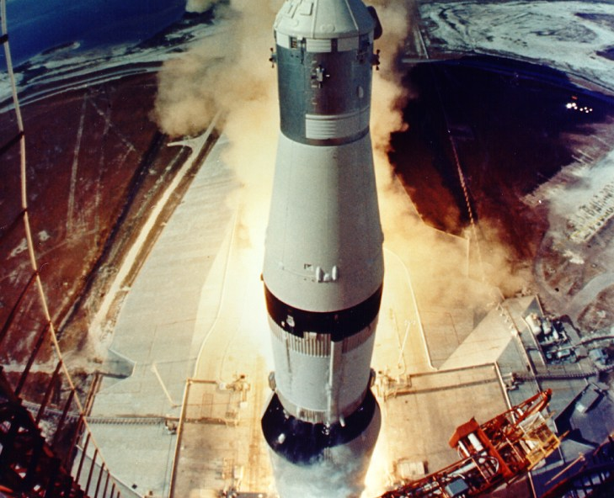
Why galaxies?
50th anniversary of Apollo 11, so I felt compelled to do something space-themed
Space buff since I was a kid
Barely remember the landing
I was a short-term member of the Galaxy Zoo project when first introduced 12 years ago

Slide 5

Pardon me while I geek out on some fun astronomy data

Slide 6


Some perspective on size
The universe is
unimaginably large
The sun
865,000 miles in diameter
If the earth were the size of basketball, the sun would be over 85 feet tall
You could fit 1.3 million earths inside the sun
93 million miles away
If you could pilot a jet to the sun at 600mph without stopping, it would take you nearly 18 years to reach it
Earth

Slide 7
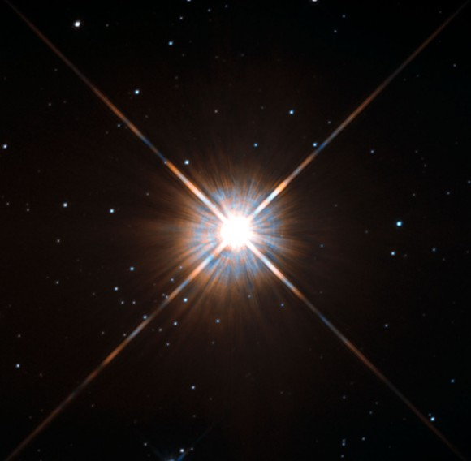
Some perspective on size
Proxima Centauri
The nearest star to our solar system
4.243 light years = 25,000,000,000,000 miles
Voyager II travels at about 10 miles per second
Could fly from New York to LA in 4.5 minutes
It would take over 80,000 years to reach Proxima Centauri

Slide 8

Some perspective on size
The Milky Way
100,000 light years across
Estimates range from 100 billion to 400 billion stars
Nearest galaxy is Andromeda
2.3 million light years away

Slide 9
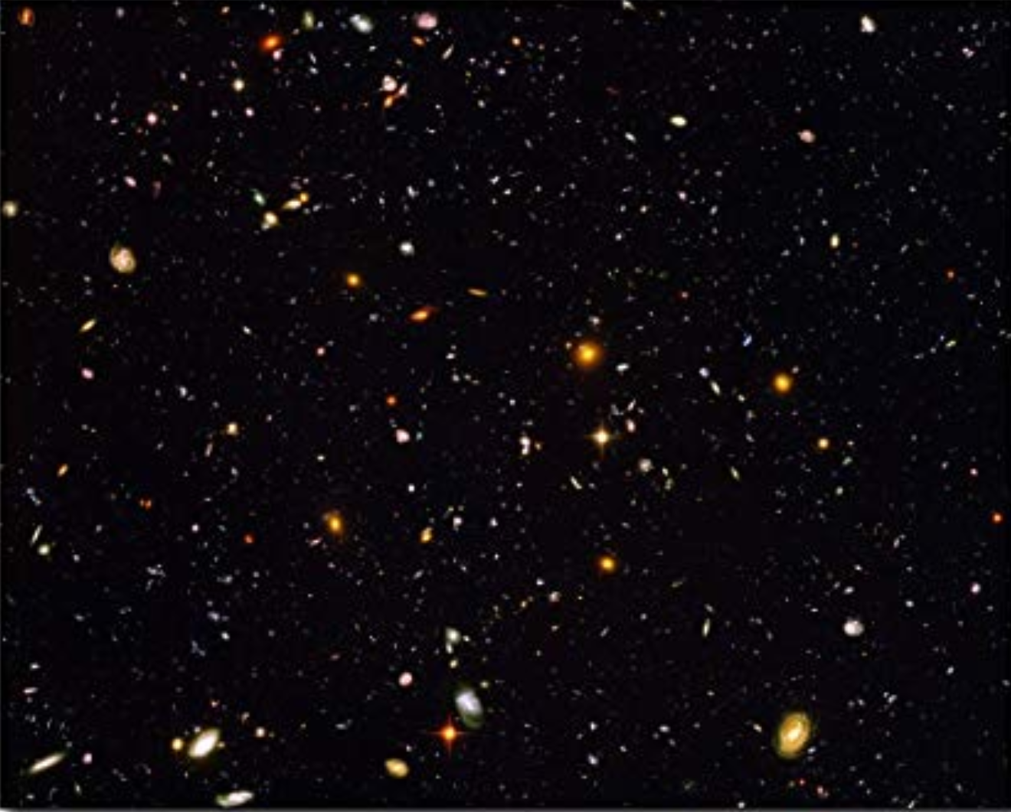
Some perspective on size
The universe
93 billion light years across
Each object/dot in this picture is a galaxy
Estimated to contain 100 billion galaxies
On average each galaxy probably contains 100 billion stars
Thus there are (theoretically) 10^22 stars in the universe
10,000,000,000,000,000,000,000 (10 sextillion) stars
Hubble Telescope Deep Field Survey

Slide 10
Some perspective on size
The universe
Although impossible to know for sure, it’s generally believed in the scientific community that there are more stars in the universe than all the grains of sand on all Earth’s beaches!
Hubble Telescope Deep Field Survey

Slide 11
The data set
Found on Kaggle
https://bit.ly/2J9XjLt
Sponsored by Galaxy Zoo Project
Over 60,000 galaxies from multiple years of sky surveys

Slide 12
The data set
The Galaxy Zoo Project
Established in 2007
Thousands of volunteers to classify hundreds of thousands of galaxy images
Data is to help astronomers understand the distribution of types and features of galaxies

Slide 13
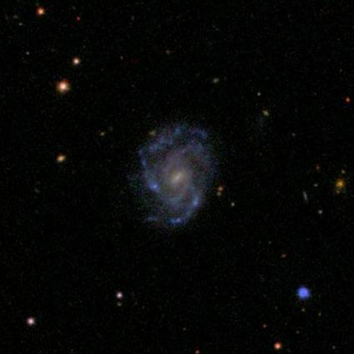
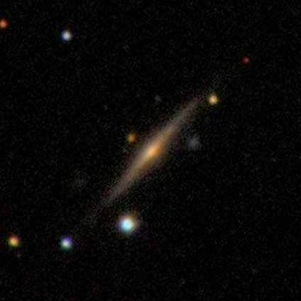
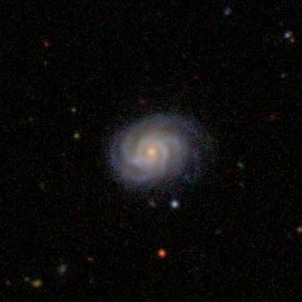
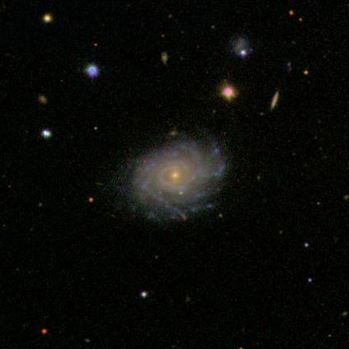
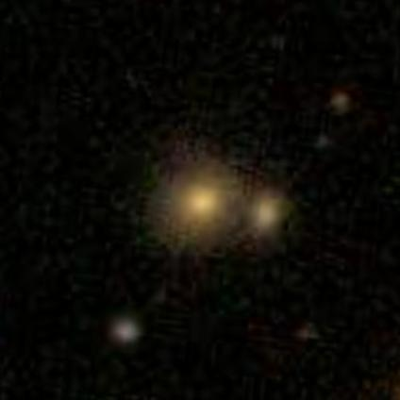
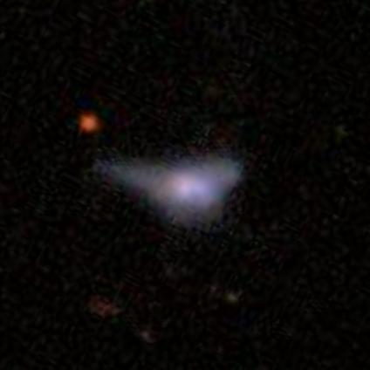

Slide 14
The question(s)
11 questions, 37 total responses
Q1. Is the object a smooth galaxy, a galaxy with features/disk or a star? 3 responses
Q2. Is it edge-on? 2 responses
Q3. Is there a bar? 2 responses
Q4. Is there a spiral pattern? 2 responses
Q5. How prominent is the central bulge? 4 responses
Q6. Is there anything "odd" about the galaxy? 2 responses
Q7. How round is the smooth galaxy? 3 responses
Q8. What is the odd feature? 7 responses
Q9. What shape is the bulge in the edge-on galaxy? 3 responses
Q10. How tightly wound are the spiral arms? 3 responses
Q11. How many spiral arms are there? 6 responses

Slide 15
The question(s)
11 questions, 37 total responses
Q1. Is the object a smooth galaxy, a galaxy with features/disk or a star? 3 responses
Q2. Is it edge-on? 2 responses
Q4. Is there a spiral pattern? 2 responses
Q7. How round is the smooth galaxy? 3 responses

Slide 16
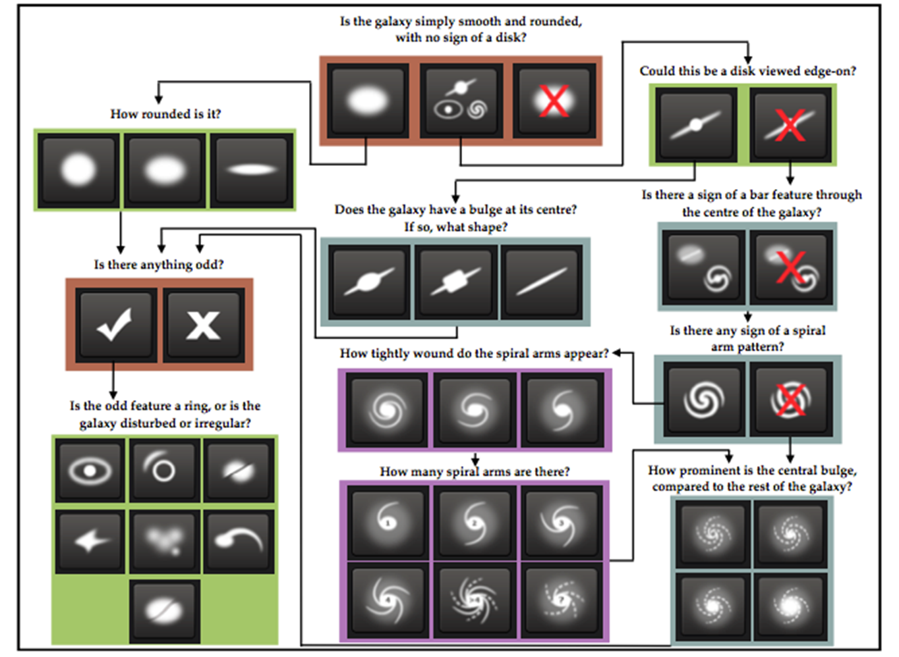
The question(s)

Slide 17
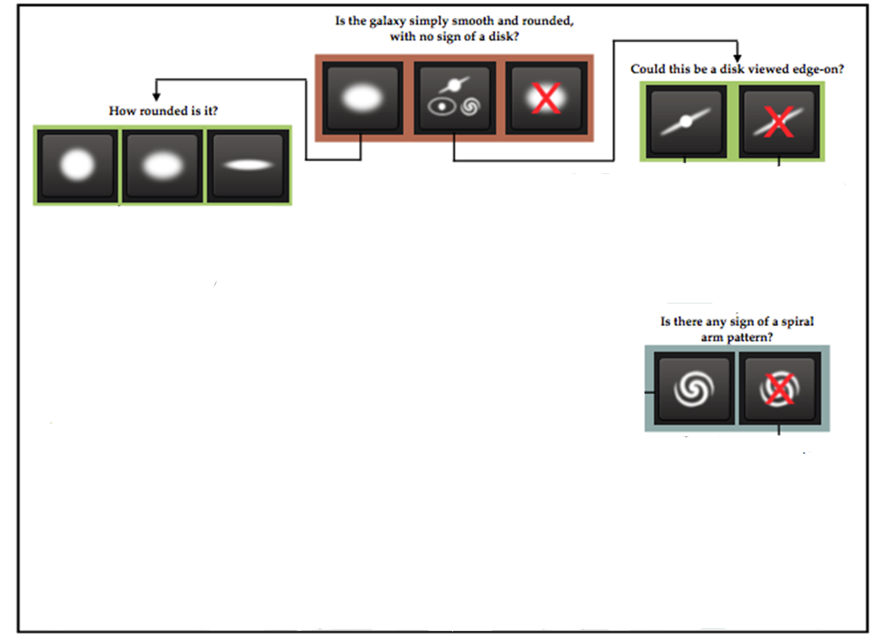
The question(s)

Slide 18
The data file
Each variable is the average percentage of volunteers’ responses to each question

Slide 19
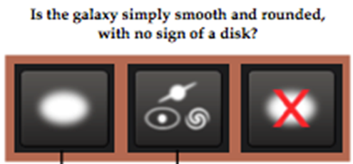
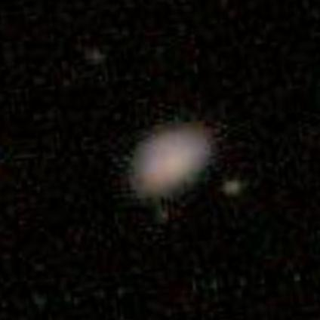
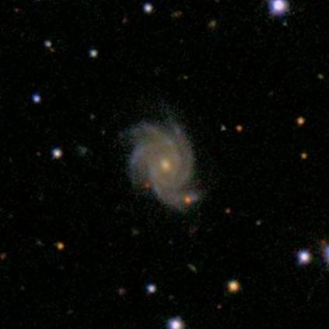
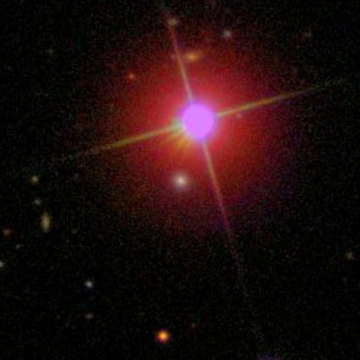
First Level
Smooth/Rounded
Features/Disk
Not a Galaxy

Slide 20
First Level

Slide 21
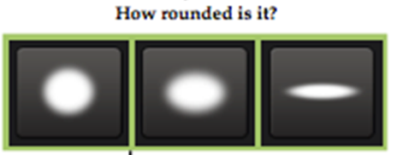
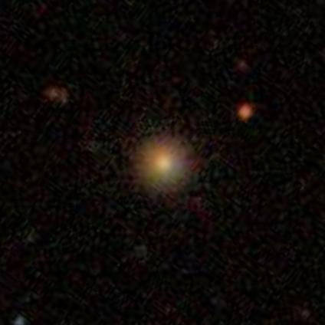
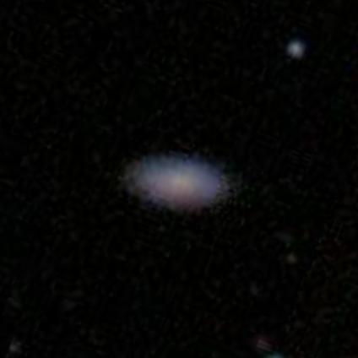
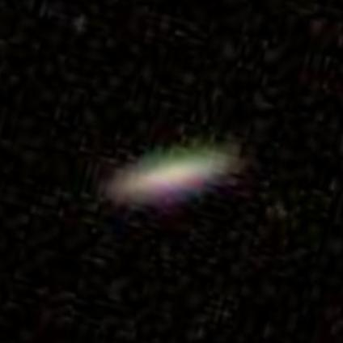
Second Level
Completely Round
Oval
Cigar-shaped

Slide 22
Second Level

Slide 23
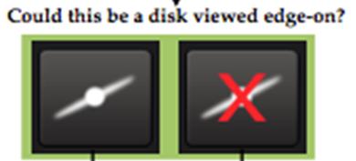
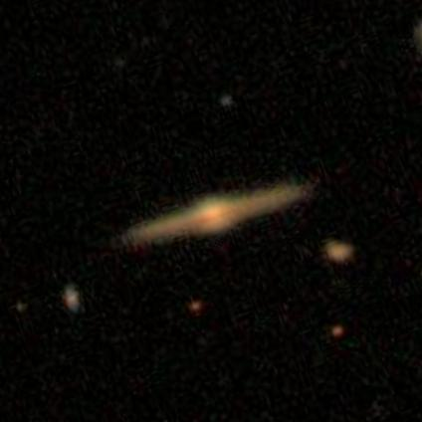
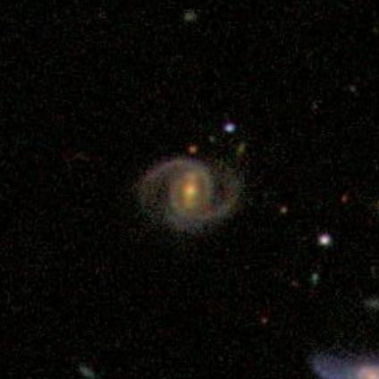
Second Level
Edge-on Disk
Not Edge-on

Slide 24
Second Level

Slide 25
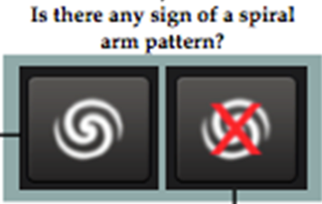
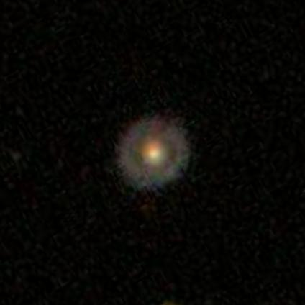
Third Level
Spiral pattern
Non-spiral pattern

Slide 26
Third Level

Slide 27
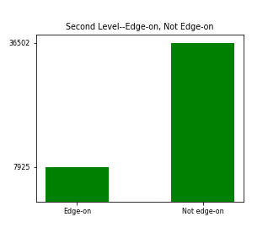
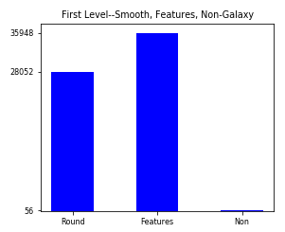
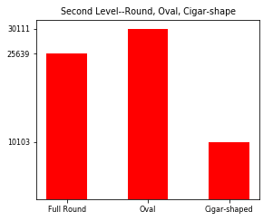
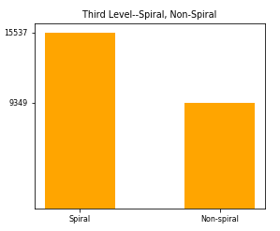
Image Distribution

Slide 28
The data file
Each variable is the average percentage of volunteers’ responses to each question
The original Kaggle competition focused on average MSE for each response
My project is changing these to categoricals and predicting the category

Slide 29
Data wrangling
Convert results of classes into categoricals – maximum value
Round
Features
Non-galaxy
Round
Features
Non-galaxy

Slide 30
Multiple tests based on response percentages
Maximum value per category (entire dataset)
At least 50% average for one category
60%, 70%, 80%, 90%
More
Tests

Slide 31
Data wrangling
Convert results of classes into categoricals – 70% minimum result
Drop all rows where the highest value < 70%
Round
Features
Non-galaxy

Slide 32
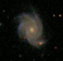
Image wrangling with OpenCV
400 pixels
100
50
50
100
Crop
Resize
400 pixels
Cut processing by 98.5%
Original image

Slide 33
Modeling data
Training: 40K images
Validation: 10K images
Testing: 10K images
Data conversion
OpenCV to convert the images to arrays
Pickled the image arrays once captured
0.3 seconds vs. 6 minutes
No need to read and process every image every time
Convert all values in solutions file to categoricals
Compared 2 neural network models using TensorFlow/Keras
Multi-Layer Perceptron (MLP)
Convolutional
Both performed well in initial tests
Convolutional, although slower, on average was about 5% better
Go with convolutional and tweak
Modeling approach

Slide 34
Convolutional parameters
Optimizers: RMSProp, SGD, Adam, Adagrad, Adadelta, Adam, Adamax
Loss function: Categorical Crossentropy (standard)
Number of Epochs
Trained between 5 and 60 epochs for analysis
Used EarlyStopping technique (stop training after 4 epochs of no improvement)
20 epochs on average before model stopped improving
Neurons/layer
Start with 32 or 64, and double in size
Little difference—in fact, starting with 64 sometimes gave worse results and took MUCH longer to run
Number of layers
Simple 3-layer
VGG-16-like technique (multiple convolutional layers and maxpooling layers)
Batch-size
64 or 128
Modeling

Slide 35
Final model
Optimizer: Adamax
Number of Epochs: Early Stopping (usually around 20)
Batch size: 64
VGG-16 like technique
2 layers of 32, maxpool, drop 0.2
3 layers of 64, maxpool, drop 0.2
4 layers of 128, maxpool, drop 0.2
Flatten, then dense layer of 256, drop 0.5
Dense layer of number of categories predicted
Modeling

Slide 36
Maximum response per category
First level (smooth/features/non-galaxy)
Train images: 40,000 Val: 10,000 Test: 10,000
Validation: 87.0 %
Test: 86.3%
Second level (1. edge-on/not-edge-on; 2. how round)
Train images: 40,000 Val: 10,000 Test: 10,000
Validation: 76.1%
Test: 76.0%
Third level (spiral/non-spiral)
Train images: 40,000 Val: 10,000 Test: 10,000
Validation: 62.6%
Test: 62.6%
Results

Slide 37
At least 50% response per category
First level (smooth/features/non-galaxy)
Train images: 39,010 Val: 9,719 Test: 9,744
Validation: 86.2%
Test: 85.9%
Second level (1. edge-on/not-edge-on; 2. how round)
Train images: 38,970 Val: 9,704 Test: 9,735
Validation: 79.4%
Test: 79.4%
Third level (spiral/non-spiral)
Train images: 27,348 Val: 6,897 Test: 6,869
Validation: 72.6%
Test: 72.0%
Results

Slide 38
At least 60% response per category
First level (smooth/features/non-galaxy)
Train images: 31,485 Val: 7,881 Test: 7,884
Validation: 91.2%
Test: 91.3%
Second level (1. edge-on/not-edge-on; 2. how round)
Train images: 28,940 Val: 7,281 Test: 7,241
Validation: 87.6%
Test: 87.3%
Third level (spiral/non-spiral)
Train images: 27,348 Val: 6,897 Test: 6,869
Validation: 78.5%
Test: 77.8%
Results

Slide 39
At least 70% response per category
First level (smooth/features/non-galaxy)
Train images: 23,882 Val: 5,950 Test: 5,983
Validation: 96%
Test: 95.8%
Second level (1. edge-on/not-edge-on; 2. how round)
Train images: 20,173 Val: 5,028 Test: 5,026
Validation: 93.4%
Test: 94%
Third level (spiral/non-spiral)
Train images: 18,709 Val: 4,686 Test: 4,661
Validation: 82.3%
Test: 83.3%
Results

Slide 40
At least 80% response per category
First level (smooth/features/non-galaxy)
Train images: 15,179 Val: 3,980 Test: 3,927
Validation: 97.5%
Test: 97.7%
Second level (1. edge-on/not-edge-on; 2. how round)
Train images: 12,332 Val: 3,085 Test: 3,037
Validation: 96%
Test: 96.3%
Third level (spiral/non-spiral)
Train images: 10,044 Val: 2,516 Test: 2,471
Validation: 90.7%
Test: 92.1%
Results

Slide 41
At least 90% response per category
First level (smooth/features/non-galaxy)
Train images: 7,323 Val: 1,828 Test: 1,845
Validation: 98.9%
Test: 98.9%
Second level (1. edge-on/not-edge-on; 2. how round)
Train images: 5,526 Val: 1,365 Test: 1,360
Validation: 98%
Test: 98.5%
Third level (spiral/non-spiral)
Train images: 3,966 Val: 941 Test: 989
Validation: 96.2%
Test: 97.2%
Results

Slide 42
Convnet did extremely well for subjective categories
This model can be used to provide high accuracy predictions of galaxy types and features
Many other things/permutations to explore
More images?
More categories
Play with percentages
Conclusion

Slide 43
So many parameters, so little time
Need to try a few out with subsets of the data
Balance accuracy with computation time
Large data set
Google Cloud Platform
Signed up for free GCP account ($300 credit)
Can use many vCPU’s and vGPU’s
Burned a lot of time wrestling with issues
Intense processing crashed Jupyter many times
Challenges

Slide 44
Thanks for watching!

